Slide 1

Where to Live in London ?
Can data science answer this question?

Slide 2
Choosing where to live is an important question?
London is a large and vibrant city, with a population of around 9 million people.
It provides work opportunities, as well as great services and amenities.
The downside of any large city is Crime, in 2018/19 there were a total of 912,000 crimes across London.
If someone was moving to London and didn’t know much about the city, and they wanted to find a place with lots of restaurants, pubs, parks and a low crime rate. which Borough should they choose to search for a place to live?
Can data science answer this question?

Slide 3
Data Collection
London Crime Data
London Crime data is available to download in a number of formats at https://data.london.gov.uk/dataset/recorded_crime_summary, multiple files are available which provide a breakdown of crimes at different geographical levels within London.
The above file doesn’t include the City of London (as it is not a Borough) but we can scape this data from the City of London police website https://www.ukcrimestats.com/Police_Force/City_of_London_Police
London Borough Information
Wikipedia resource provides a list of all the London boroughs, which can be scraped at https://en.wikipedia.org/wiki/List_of_London_boroughs, this dataset includes the latitude and longitude of each borough, along with population estimates and the area in square miles of the borough.
House Price Information
House price information can be scraped from the UK Government website https://www.gov.uk/government/publications/uk-house-price-index-england-march-2020/uk-house-price-index-england-march-2020
Venue Data
Information on types and numbers of venues such as restaurants, pubs and parks withing a geographical area is available from https://foursquare.com/
Geographical Data
A .json file providing the coordinates of the boundaries of the London boroughs is available at https://skgrange.github.io/www/data/london_boroughs.json

Slide 4
Data Preparation
Crime data was downloaded and cleaned, the total number of crimes for the year 2019 calculated for each London borough
London borough data was scraped from Wikipedia, and cleaned (removal of white spaces, reformatting of Latitude and longitude to a format supported by the Foursquare API)
House price data was scraped, cleaned and filtered
Foursquare venue data was downloaded, through the Foursquare API, using the latitude and longitude co-ordinates provided by Wikipedia, with a radius of 2000 meters to give a list of venues by category for each borough. This data was one-hot encoded and the mean frequency of each venue category for each borough calculated, the top ten venue categories per borough were calculated.
The data was combined to provide a dataset for analysis
Crime rate per 1000 population was calculated for each London borough using the total crime, and population data

Slide 5
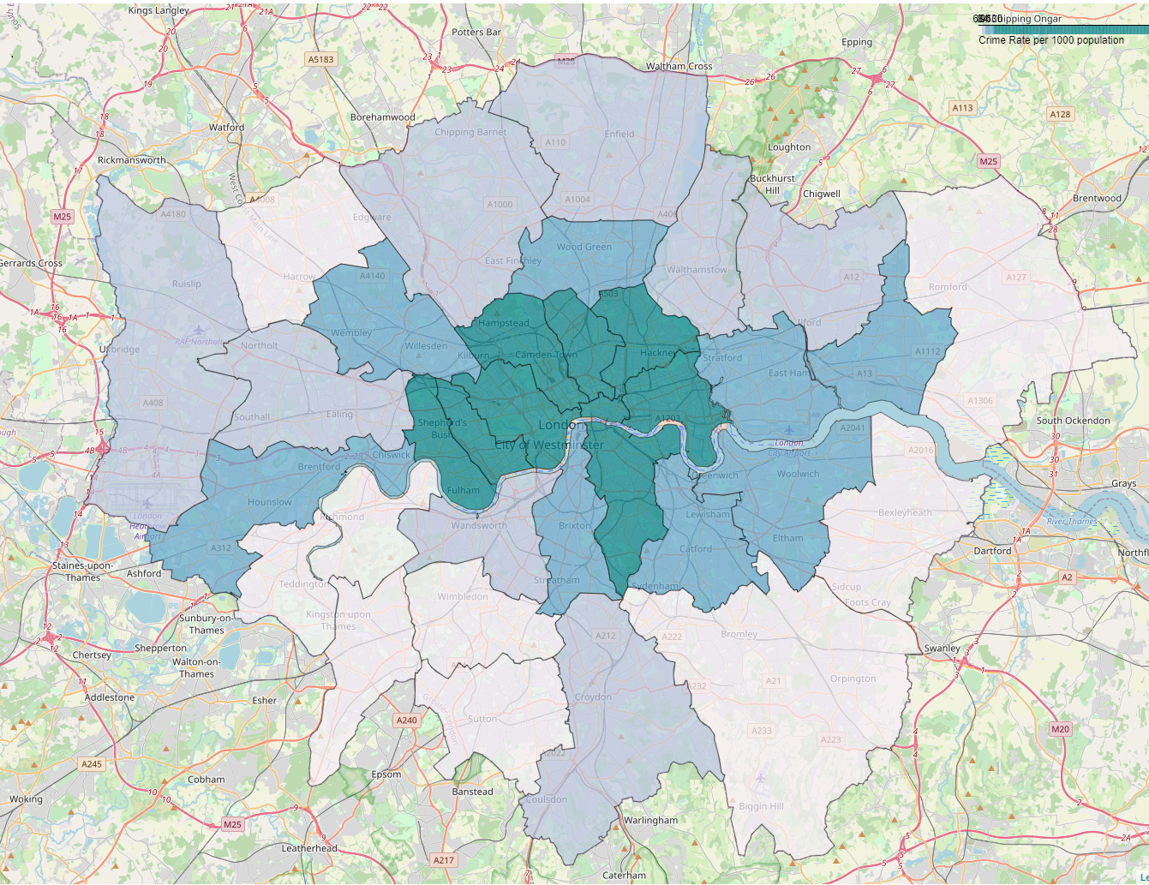
Crime
Choropleth map of the crime rate per 1000 population for each of the London boroughs Light areas are low crime, while dark areas represent higher crime rates As expected, the centre of London has the boroughs with the highest crime rates. While the suburbs particularly in the south west, and some boroughs in the east of London show lower crime rates

Slide 6
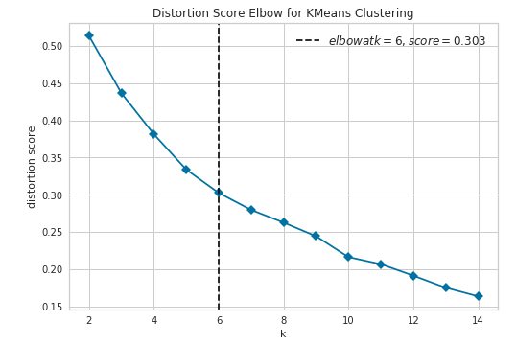
Clustering Analysis
K Means clustering was utilized on the venues data to identify boroughs with similarities in venues, with the aim to identify a cluster with the target characteristics of restaurants pubs and parks. The elbow method was used to determine the optimal value of K.
Yellowbrick (https://www.scikit-yb.org/en/latest/) provides additional tools for visualisation for machine learning, their elbow method plot was utilized to determine the value of K
K = 6 was determined to be the optimal value

Slide 7
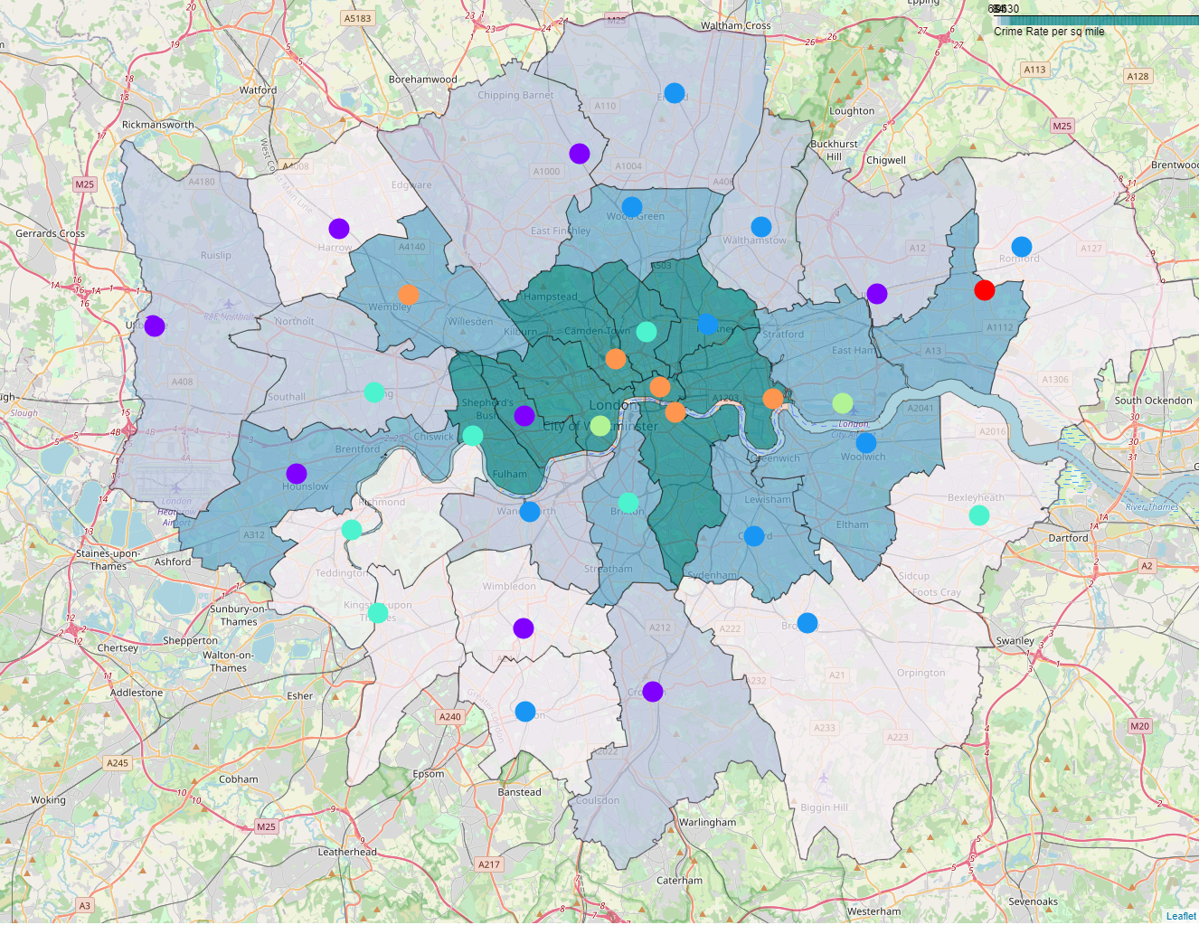
Visualisation of the clusters
K Means clustering was run on the venues data with a K of 6, the resulting clusters were then added to the dataset and plotted over the map of London Crime rates
Analysis of Clusters showed cluster 3 to be the closest match to our criteria of restaurants, pubs and parks

Slide 8
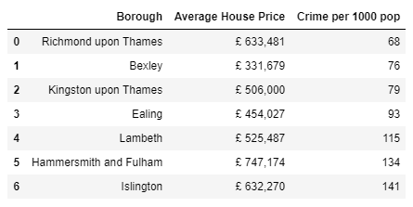
Conclusion
Based on the clustering analysis cluster 3 meets the criteria for areas with restaurants, pubs and parks.
The following table shows the Boroughs in cluster 3 and the associated Average House Price and Crime per 1000 population.
Richmond upon Thames, Bexley, Kingston upon Thames, and Ealing meet the criteria of low crime rate (less than 100 crimes per 1000 population in 2019) and Restaurants, Pubs and Parks.

Slide 9
Can data science answer where to live in London?
YES!
If you want lots of Restaurants, Pubs and Parks and a low crime rate then you consider : Richmond upon Thames, Bexley, Kingston upon Thames, and Ealing

